Slide 1
Internship Project Showcase
By Hardik Linzara
BCA (DS&BDA) | Roll No: 23/SCA/BCA(DS&BDA)/013

Slide 2
About Prodigy Infotech
Innovative organization for tech education
Hands-on internships in Web Dev, AI, Data Science, and Cybersecurity
Focus on real-world projects and mentorship

Slide 3
Internship Objective
Apply classroom knowledge to real-world scenarios
Build responsive, interactive web applications
Gain experience in front-end technologies (HTML, CSS, JS)

Slide 4
Project 1: Responsive Landing Page
Fixed navigation bar with hover and scroll effects
Tech Used: HTML5, CSS3, JavaScript
Key Skills: DOM manipulation, responsive design

Slide 5
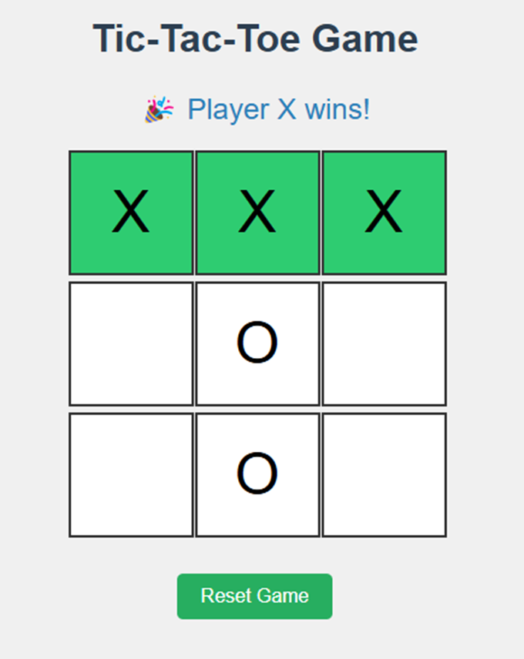

Slide 6
Project 2: Tic-Tac-Toe Game
Browser-based stopwatch with lap, pause, reset features
Tech Used: HTML, CSS, JavaScript
Key Skills: set Interval, event handling, UI responsiveness

Slide 7
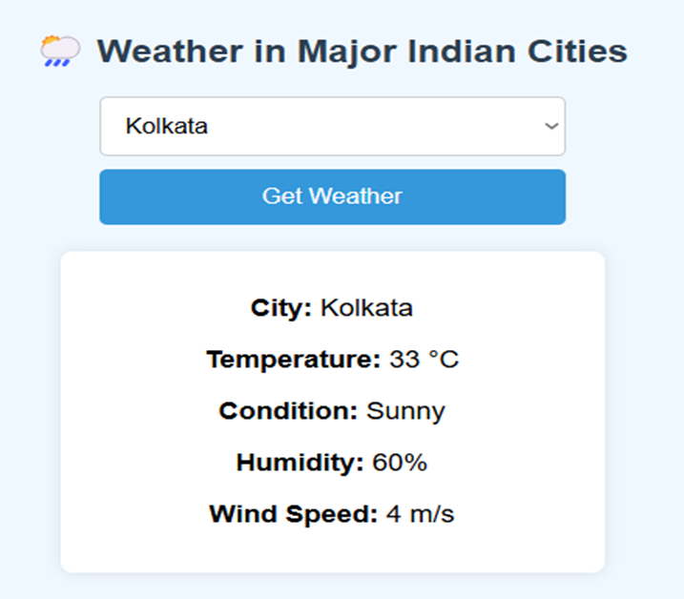

Slide 8
Project 3: Personal Portfolio Website
2-player interactive game on a 3x3 grid
Tech Used: HTML5, CSS3, JavaScript
Key Skills: game logic, DOM interaction, win detection

Slide 9
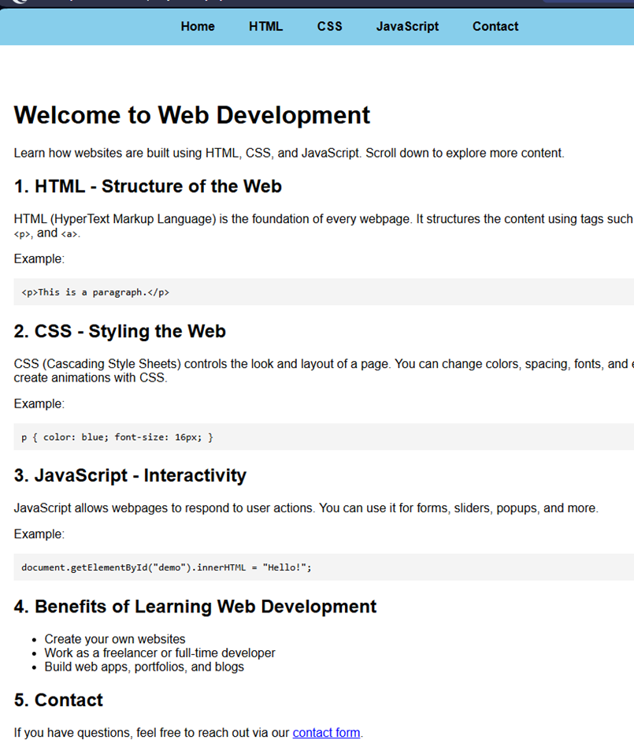

Slide 10
Project 4: Weather Web Application
Personal site with sections for skills, projects, contact
Fully responsive design with smooth navigation
Used to showcase internship and academic work

Slide 11
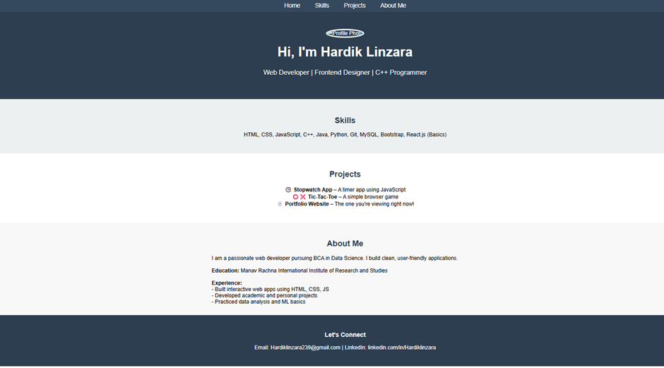

Slide 12
Skills & Technologies Used
HTML5, CSS3, JavaScript
Responsive Design & DOM Manipulation
API Integration, UI/UX Development

Slide 13
Takeaways from Internship
Improved collaboration and time management
Real-world project execution and problem-solving
Confidence in developing deployable web solutions

Slide 14
Future Aspirations
Learn advanced frameworks like React & Node.js
Enhance UI dynamics with animation libraries
Contribute to open source and build scalable applications

